Slide 1




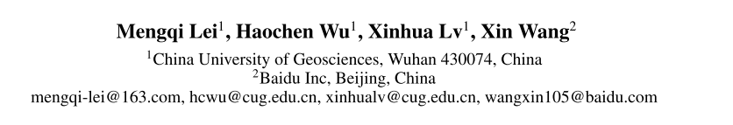



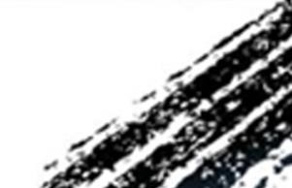

ATAI
Advanced Technique of Artificial Intelligence
ATAI
ChongqingUniversity _{AdvancedTechniqueof}
of Technology Artificial Intelligence
Chongqing University of
Technology
Chongqing University ^{ATAI}
_{of Technology} Advanced Techniqueof
Artificial Intelligence
Chongqing University of Technology
Chongqing University of Technology
ConDSeg: A General Medical Image Segmentation Framework via
Contrast-Driven Feature Enhancement
Code:https://github.com/Mengqi-Lei/ConDSeg
——AAAI 2025
Reported by Xiang Zhang
1

Slide 2
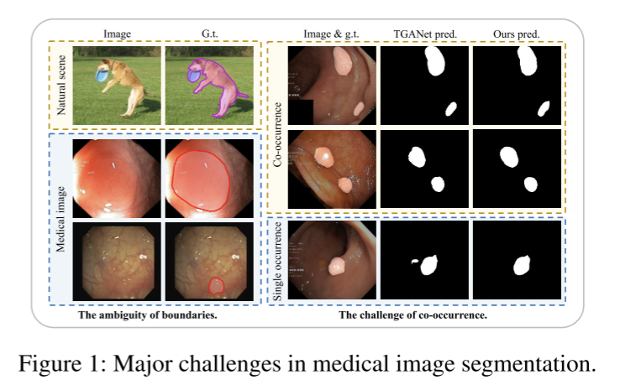
ATAI
Advanced Technique of Artificial Intelligence
ATAI
ChongqingUniversity _{AdvancedTechniqueof}
of Technology Artificial Intelligence
Chongqing University of
Technology
Chongqing University ^{ATAI}
_{of Technology} Advanced Techniqueof
Artificial Intelligence
Chongqing University of Technology
Chongqing University of Technology
Motivation
Medical image segmentation still faces two major challenges. On the one hand, there is often a “soft boundary” between foreground and background in medical images,On the other hand, co-occurrence phenomena are widespread in medical images, and learning these features is misleading to the model’s judgment

Slide 3
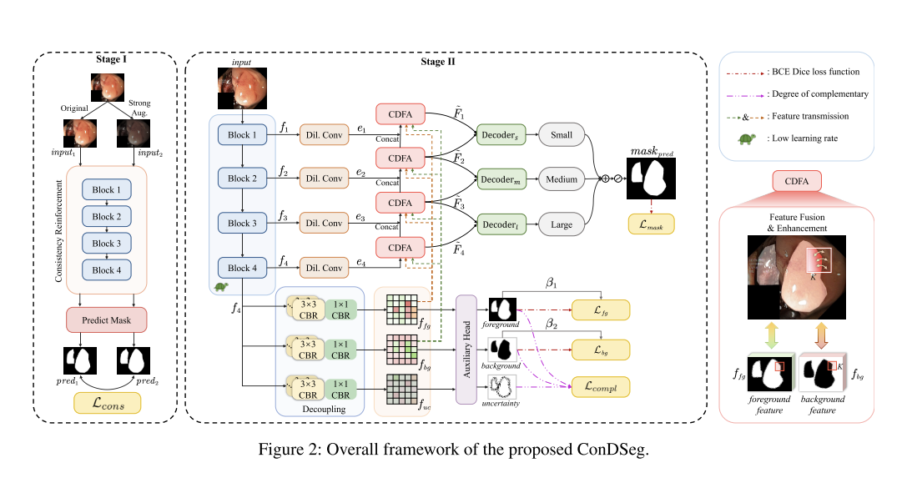
ATAI
Advanced Technique of Artificial Intelligence
ATAI
ChongqingUniversity _{AdvancedTechniqueof}
of Technology Artificial Intelligence
Chongqing University of
Technology
Chongqing University ^{ATAI}
_{of Technology} Advanced Techniqueof
Artificial Intelligence
Chongqing University of Technology
Chongqing University of Technology
Overview

Slide 4
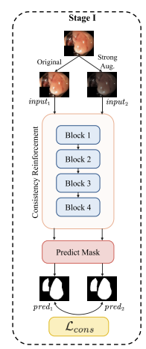
ATAI
Advanced Technique of Artificial Intelligence
ATAI
ChongqingUniversity _{AdvancedTechniqueof}
of Technology Artificial Intelligence
Chongqing University of
Technology
Chongqing University ^{ATAI}
_{of Technology} Advanced Techniqueof
Artificial Intelligence
Chongqing University of Technology
Chongqing University of Technology
Method
in the first stage, our objective is to maximize the feature extraction capability of the Encoder and its robustness under weak illumination and low contrast scenarios. To achieve this, we isolate the Encoder from the whole network and design a prediction head for it. We ensure that the structure of this prediction head is as simple as possible to avoid providing additional structures with feature-extraction capability beyond the Encoder blocks, thereby optimizing the Encoder performance as much as possible. We refer to this initial training network in the first stage as Net0.

Slide 5
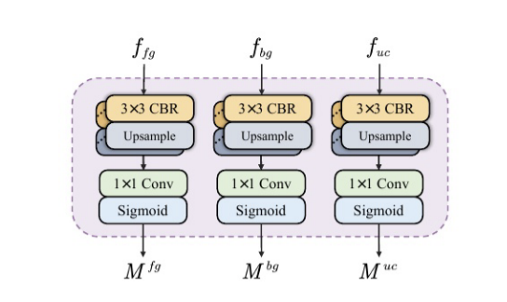
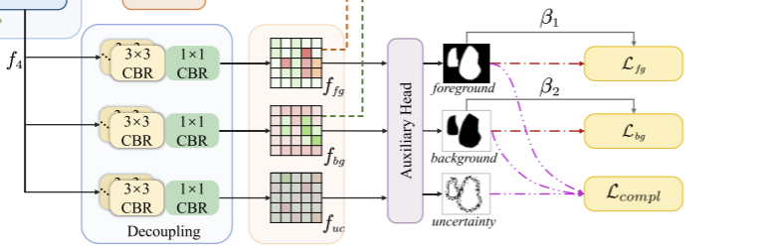
ATAI
Advanced Technique of Artificial Intelligence
ATAI
ChongqingUniversity _{AdvancedTechniqueof}
of Technology Artificial Intelligence
Chongqing University of
Technology
Chongqing University ^{ATAI}
_{of Technology} Advanced Techniqueof
Artificial Intelligence
Chongqing University of Technology
Chongqing University of Technology
Method
SID begins with three parallel branches, each consisting of multiple CBR blocks. The feature map f4 from the Encoder is inputted into these three branches to obtain three feature maps with different semantic information,ffg, fbg, fuc, which are enriched with the foreground, background, and uncertainty region features respectively. The three feature maps are then predicted by an auxiliary head to produce masks for the foreground (Mfg), background(Mbg), and regions of uncertainty (Mfg).

Slide 6
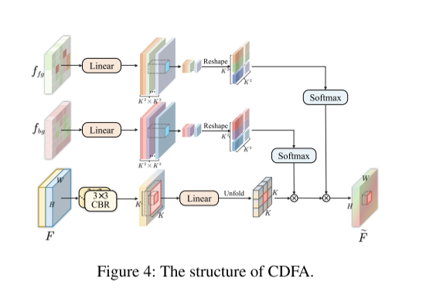
ATAI
Advanced Technique of Artificial Intelligence
ATAI
ChongqingUniversity _{AdvancedTechniqueof}
of Technology Artificial Intelligence
Chongqing University of
Technology
Chongqing University ^{ATAI}
_{of Technology} Advanced Techniqueof
Artificial Intelligence
Chongqing University of Technology
Chongqing University of Technology
Method
Specifically, given the input feature map F ∈
RH×W×C, it is first subjected to preliminary fusion through multiple CBR blocks. Subsequently, this C-dimensional feature vector is mapped to a value vector V ∈ RH×W×C through a linear layer weight WV ∈ RC×C. The value vector V is then unfolded over each local window, preparing to aggregate neighborhood information for each position.

Slide 7
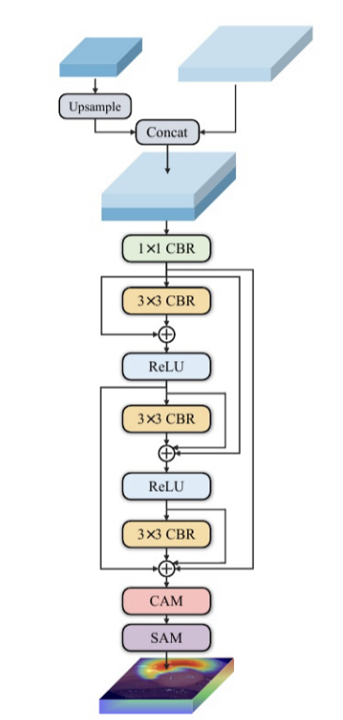
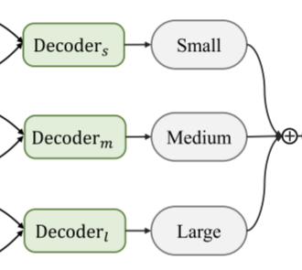
ATAI
Advanced Technique of Artificial Intelligence
ATAI
ChongqingUniversity _{AdvancedTechniqueof}
of Technology Artificial Intelligence
Chongqing University of
Technology
Chongqing University ^{ATAI}
_{of Technology} Advanced Techniqueof
Artificial Intelligence
Chongqing University of Technology
Chongqing University of Technology
Method
SA-Decoder implements separate predictions by distributing entities of different sizes in different layers. Among the features outputted by multiple CDFAs, the shallow-level feature maps contain more fine-grained information, making them suitable for predicting smaller-sized entities. As the layers deepen,the feature maps incorporate increasing amounts of global information and higher-level semantics, making them more suitable for predicting larger-sized entities.

Slide 8


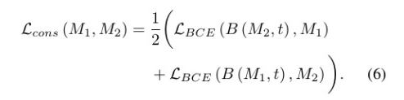
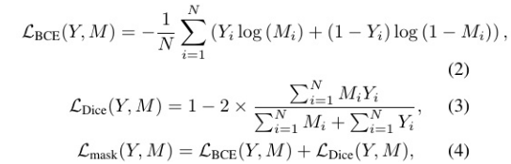
ATAI
Advanced Technique of Artificial Intelligence
ATAI
ChongqingUniversity _{AdvancedTechniqueof}
of Technology Artificial Intelligence
Chongqing University of
Technology
Chongqing University ^{ATAI}
_{of Technology} Advanced Techniqueof
Artificial Intelligence
Chongqing University of Technology
Chongqing University of Technology
Method

Slide 9








ATAI
Advanced Technique of Artificial Intelligence
ATAI
ChongqingUniversity _{AdvancedTechniqueof}
of Technology Artificial Intelligence
Chongqing University of
Technology
Chongqing University ^{ATAI}
_{of Technology} Advanced Techniqueof
Artificial Intelligence
Chongqing University of Technology
Chongqing University of Technology
Method

Slide 10
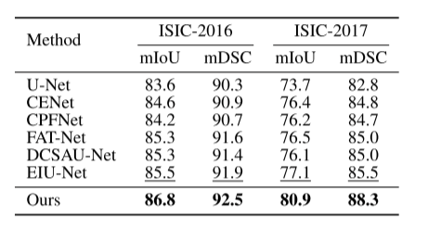
ATAI
Advanced Technique of Artificial Intelligence
ATAI
ChongqingUniversity _{AdvancedTechniqueof}
of Technology Artificial Intelligence
Chongqing University of
Technology
Chongqing University ^{ATAI}
_{of Technology} Advanced Techniqueof
Artificial Intelligence
Chongqing University of Technology
Chongqing University of Technology
Experiments

Slide 11
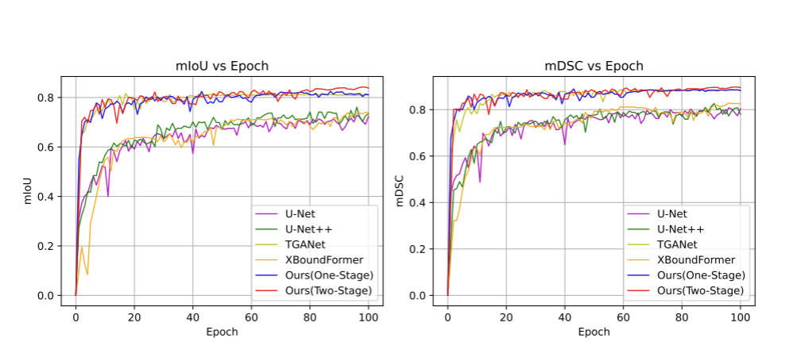
ATAI
Advanced Technique of Artificial Intelligence
ATAI
ChongqingUniversity _{AdvancedTechniqueof}
of Technology Artificial Intelligence
Chongqing University of
Technology
Chongqing University ^{ATAI}
_{of Technology} Advanced Techniqueof
Artificial Intelligence
Chongqing University of Technology
Chongqing University of Technology
Experiments

Slide 12
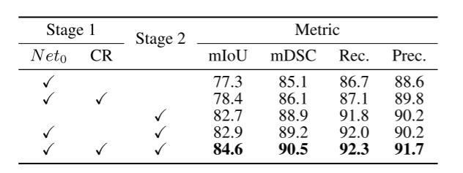
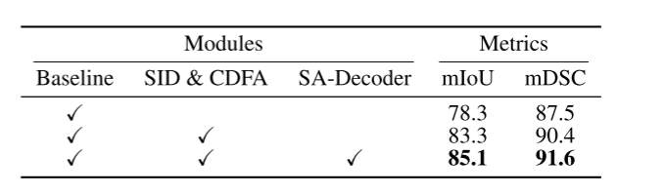
ATAI
Advanced Technique of Artificial Intelligence
ATAI
ChongqingUniversity _{AdvancedTechniqueof}
of Technology Artificial Intelligence
Chongqing University of
Technology
Chongqing University ^{ATAI}
_{of Technology} Advanced Techniqueof
Artificial Intelligence
Chongqing University of Technology
Chongqing University of Technology
Experiments

Slide 13


ATAI
Advanced Technique of Artificial Intelligence
ATAI
ChongqingUniversity _{AdvancedTechniqueof}
of Technology Artificial Intelligence
Chongqing University of
Technology
Chongqing University ^{ATAI}
_{of Technology} Advanced Techniqueof
Artificial Intelligence
Chongqing University of Technology
Chongqing University of Technology
Thanks!

